Slide 1
E-Commerce Sales Analysis

Slide 2
Industry Overview: Flipkart leads the market
The Indian e-commerce industry is projected to reach US$ 325 billion by 2030, experiencing significant growth.
The e-commerce market’s share of Tier-3 cities grew from 34.2% in 2021 to 41.5% in 2022.
India's Business-to-Business (B2B) online marketplace would be a US$ 200 billion opportunity by 2030.
Source: IBEF, Bernstein
Industry Overview
Amazon
Flipkart
Meesho
Comparative Analysis
Notes:
driven by rising internet and smartphone penetration, convenience of quick delivery, and accelerated adoption during COVID-19, with diverse product categories and order value segments catering to evolving consumer preferences, and the domination of metropolitan cities presenting significant opportunities for retailers and key players to capitalize on the rapidly expanding market

Slide 3


Slide 4
GOV
Monthly Active
Users
User Growth
$18 billion
40 million
YoY: 13 %
YoY Growth: 3.4%
FY 2023
FY 2023
Total Products
Loss
Sellers
60 crore
Rs 4,854 crore
10 Lakh
12 crore amazon products
FY 2023
FY 2023
Industry Overview
Amazon
Flipkart
Meesho
Comparative Analysis

Slide 5
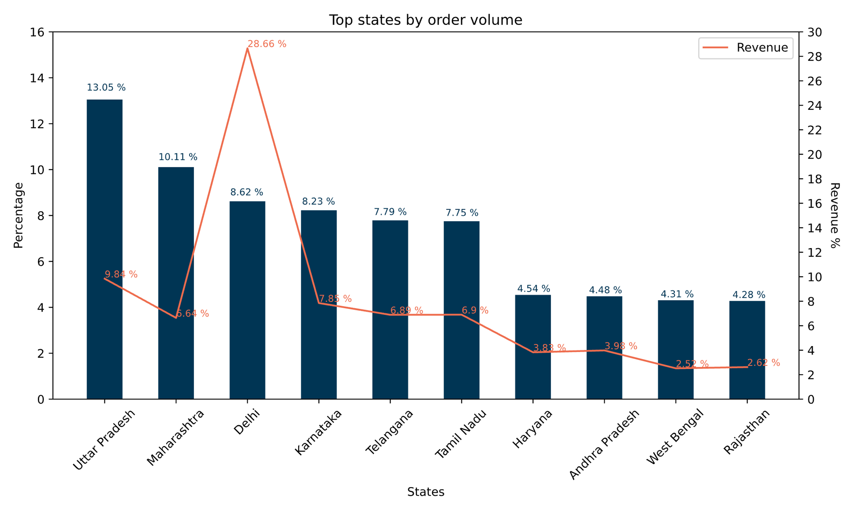
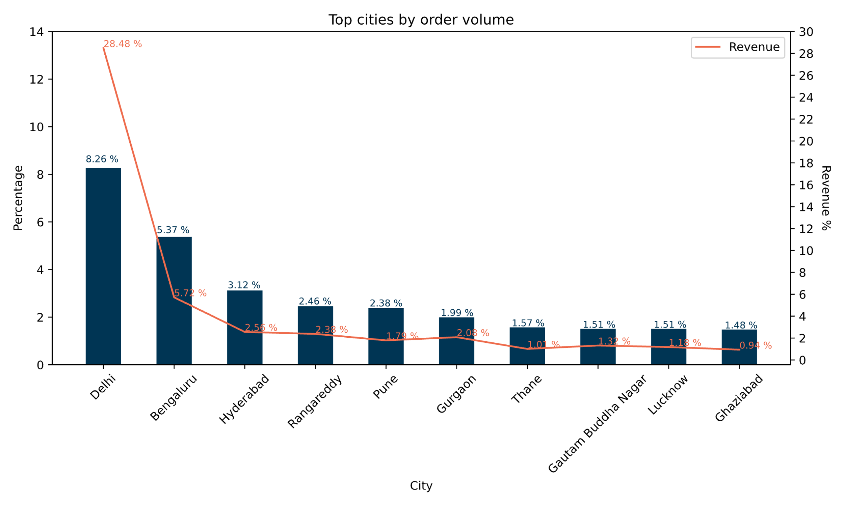
Geographic Analysis
Delhi is third on the basis of volume, but highest in revenue. This trend might be observed because the people residing there tend to purchase expesnive products more and in much larger quantities
Industry Overview
Amazon
Flipkart
Meesho
Comparative Analysis

Slide 6
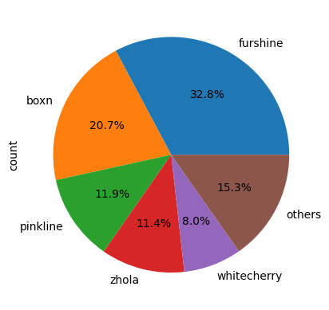
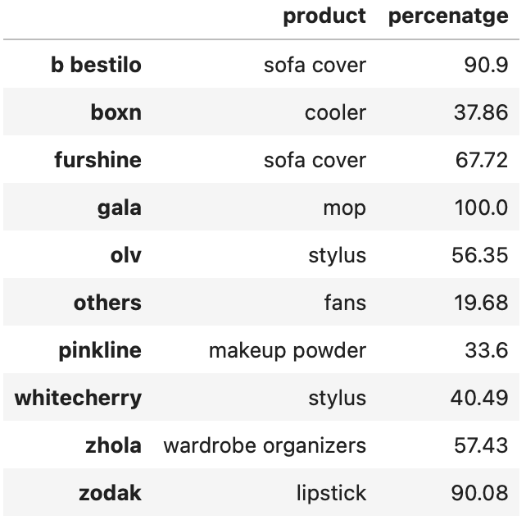
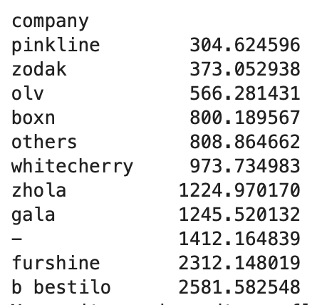
Top companies by order volume and their most selling products
Top companies
Top selling products
Average Order Value
Furshine is the top company on the basis of order volume as well as revenue.
The item which is being sold most is sofa covers, which sold majorly by furshine and bestilo
The average order value is highest for bestilo followed by furshine
Industry Overview
Amazon
Flipkart
Meesho
Comparative Analysis

Slide 7
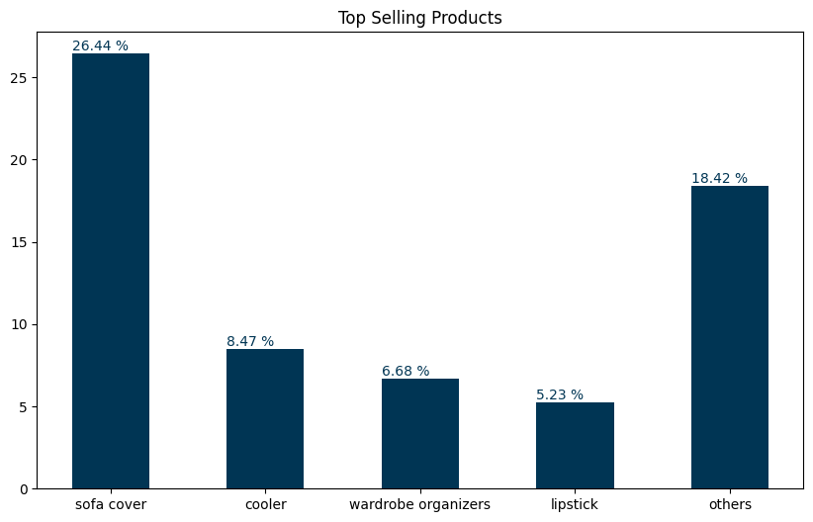
Top companies by order volume and their most selling products
Quarter of the sales is of sofa cover
Industry Overview
Amazon
Flipkart
Meesho
Comparative Analysis

Slide 8
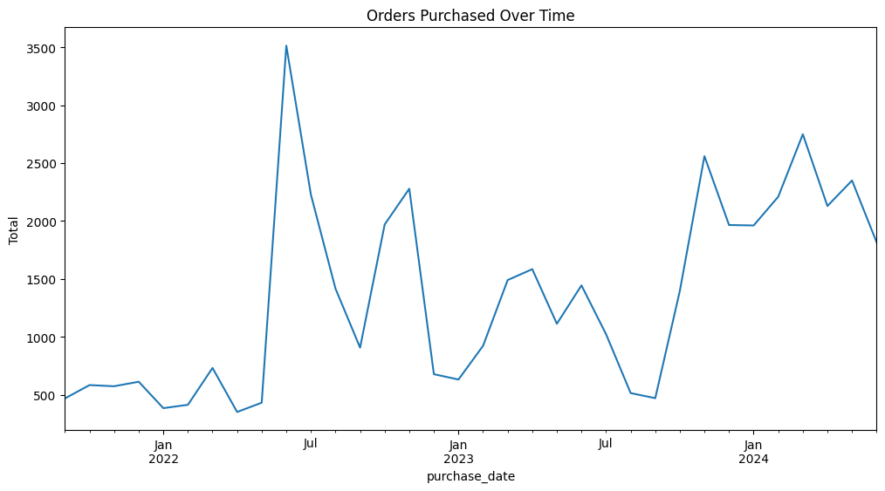
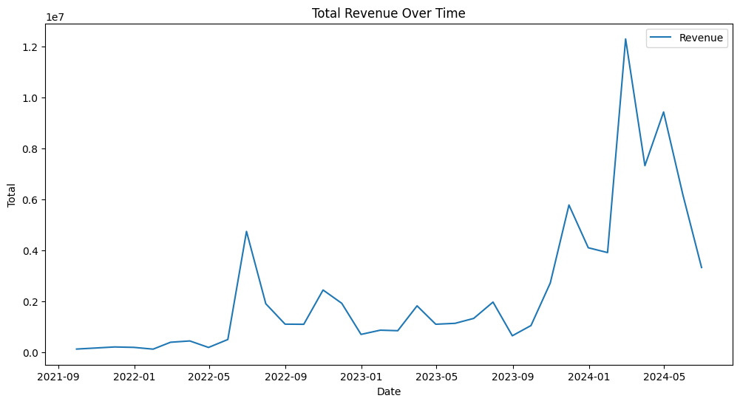
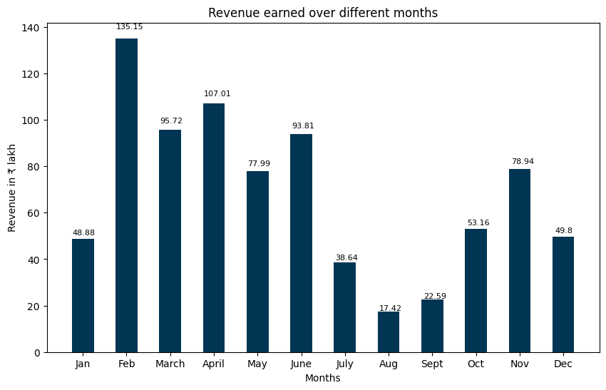
Purchase and Revenue Trends
Industry Overview
Amazon
Flipkart
Meesho
Comparative Analysis

Slide 9
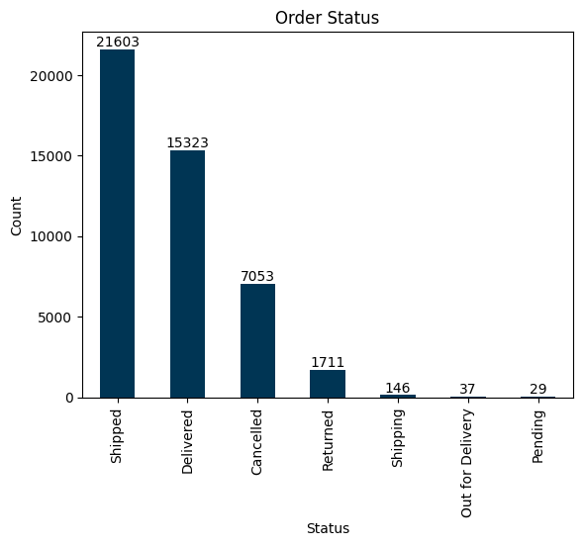
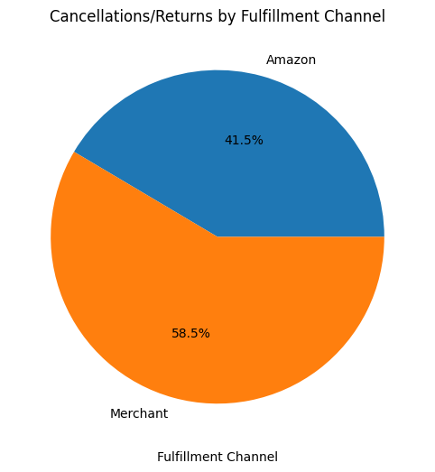
Order Status
Industry Overview
Amazon
Flipkart
Meesho
Comparative Analysis

Slide 10
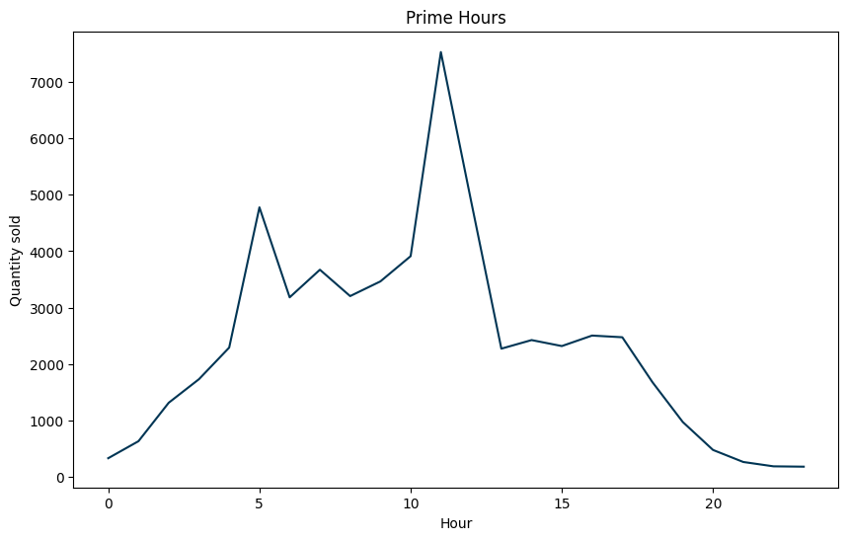
Prime Hours – Boost sales using advertisements and push notifications
Industry Overview
Amazon
Flipkart
Meesho
Comparative Analysis

Slide 11
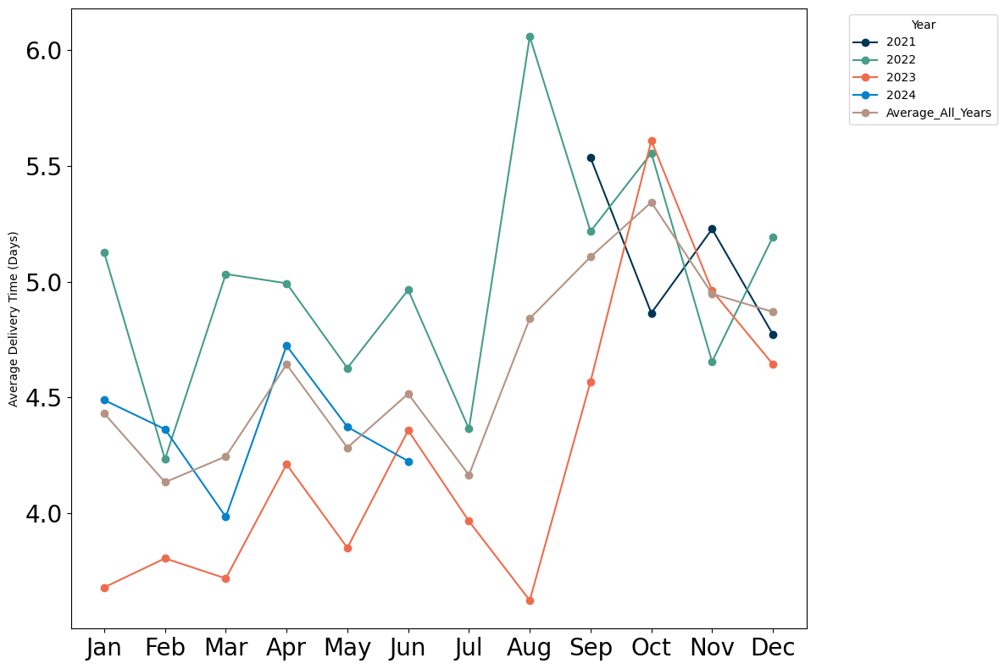
Average Delivery Time
2022 – 5 days
2023 – 4.25 days
Average delivery time has decreased over the years, indicating an improvement in the supply chain and logistics
Industry Overview
Amazon
Flipkart
Meesho
Comparative Analysis

Slide 12


Slide 13
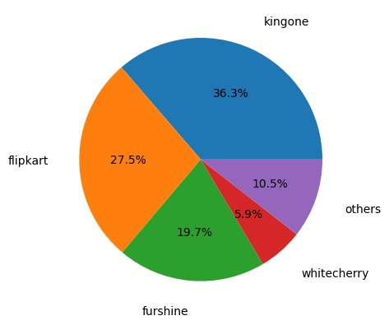
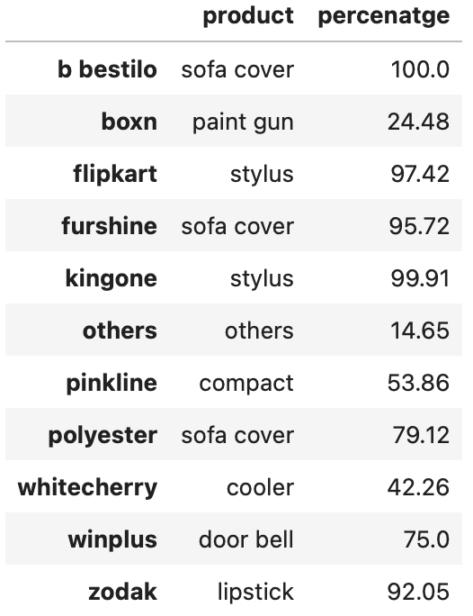
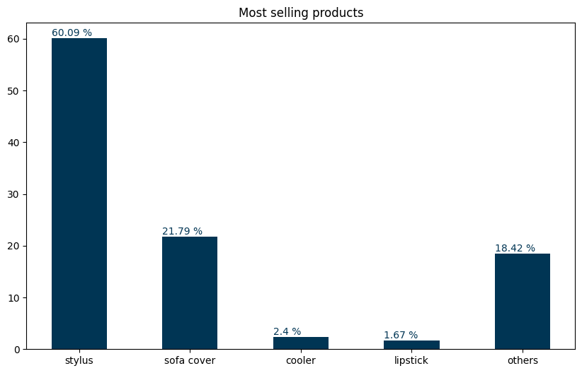
Top companies by order volume and their most selling products
Top companies
Top selling products of each company
Top selling products
Industry Overview
Amazon
Flipkart
Meesho
Comparative Analysis

Slide 14
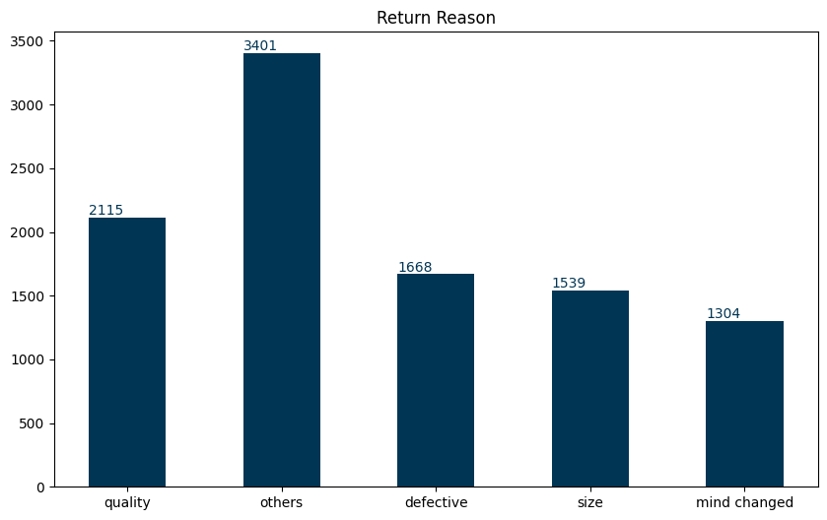
Reasons for return
Industry Overview
Amazon
Flipkart
Meesho
Comparative Analysis

Slide 15
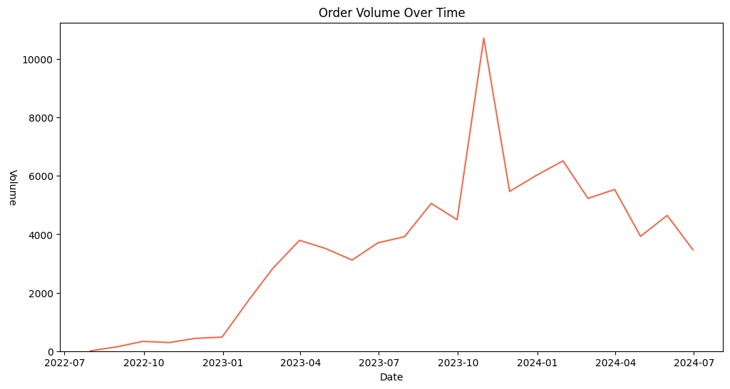
Purchase Trend
Industry Overview
Amazon
Flipkart
Meesho
Comparative Analysis

Slide 16
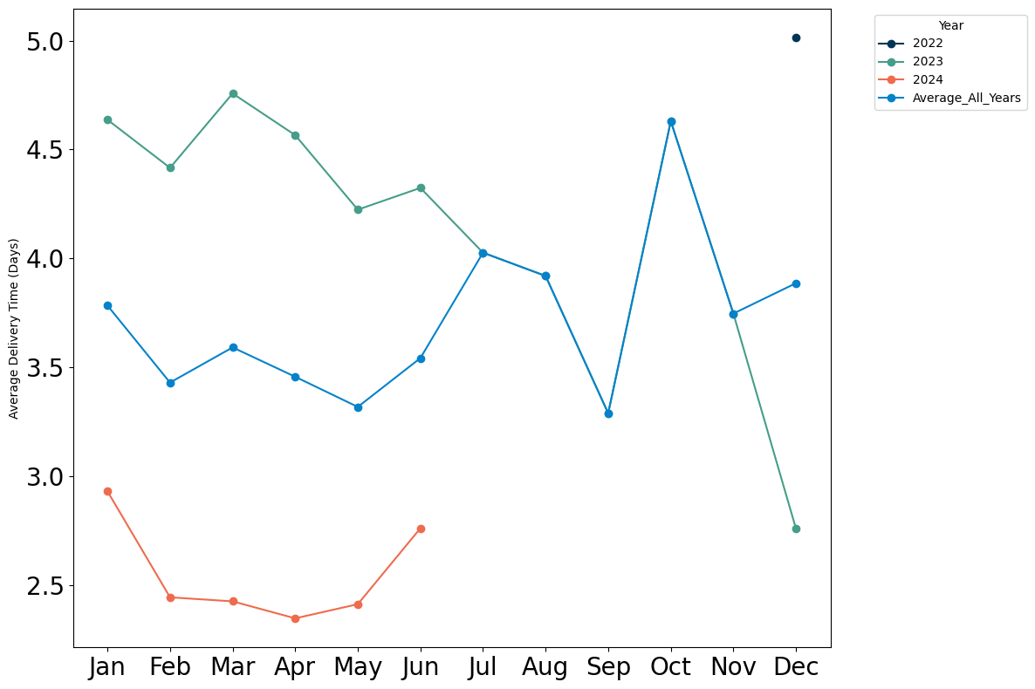
Average Delivery Time
2022 – 5 days
2023 – 4.1 days
2024 – 2.5 days
Average delivery time has decreased over the years, indicating an improvement in the supply chain and logistics
Industry Overview
Amazon
Flipkart
Meesho
Comparative Analysis

Slide 17
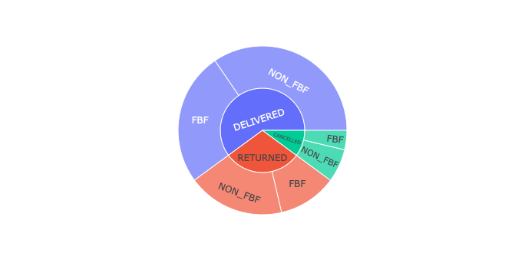
Fulfillment Types and Order Status
3rd party logistics have a higher rate of cancellation and returns
Industry Overview
Amazon
Flipkart
Meesho
Comparative Analysis

Slide 18


Slide 19
User Base grew at 32% YoY
Meesho's growth is in sync with the growth of ecommerce in tier-2 and smaller cities in India
Meesho is the fastest growing ecommerce platform in India with around 120 million average monthly active users
The report attributed growth in Meesho's market share primarily to its strategic focus Tier 11 and smaller cities due to its mass positioning, operating through a zero commission model.
Most products on the Meesho marketplace are unbranded. The report puts the number to as high as 95%.
Order volume grew 43% YoY with revenue growth at 54%
Industry Overview
Amazon
Flipkart
Meesho
Comparative Analysis

Slide 20
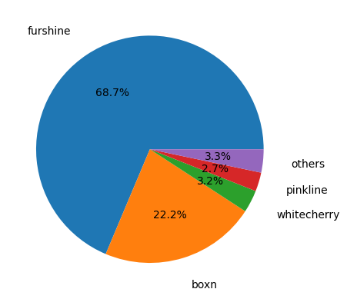
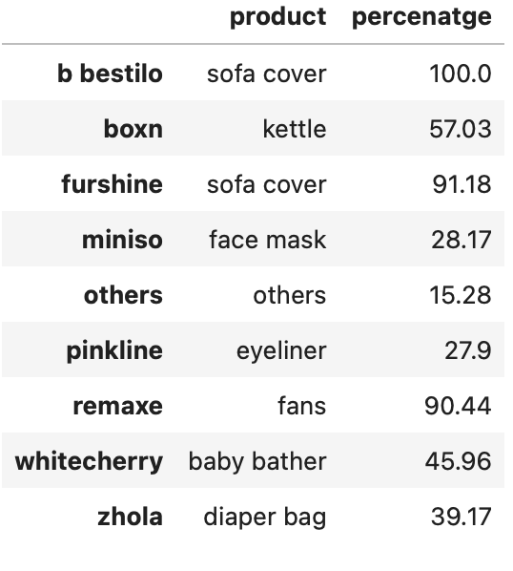
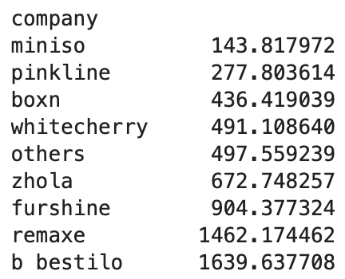
Top companies by order volume and their most selling products
Top companies
Top selling products
Average Order Value
Industry Overview
Amazon
Flipkart
Meesho
Comparative Analysis

Slide 21
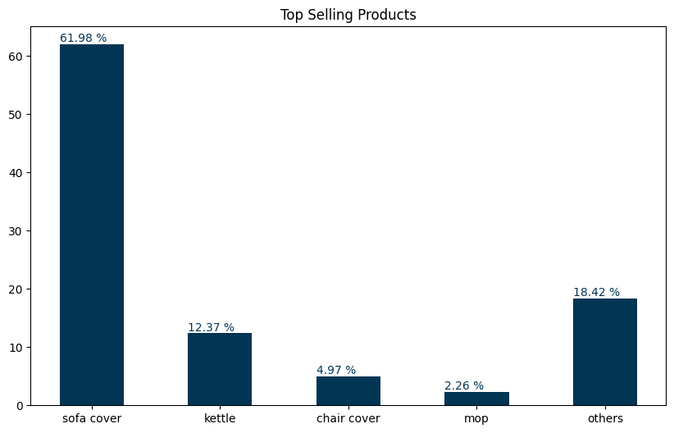
Top selling products
Industry Overview
Amazon
Flipkart
Meesho
Comparative Analysis

Slide 22
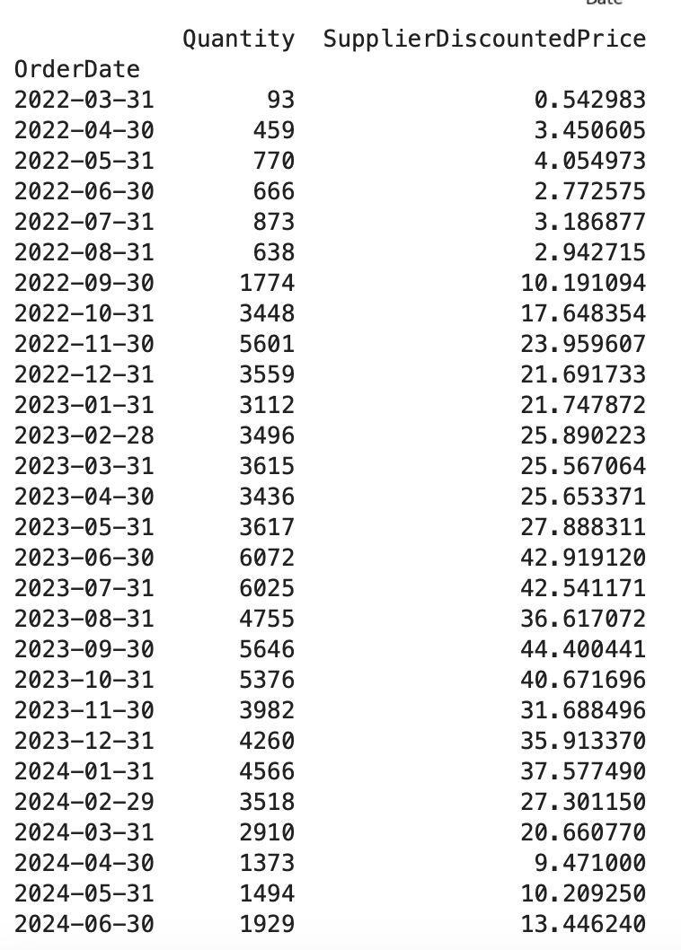
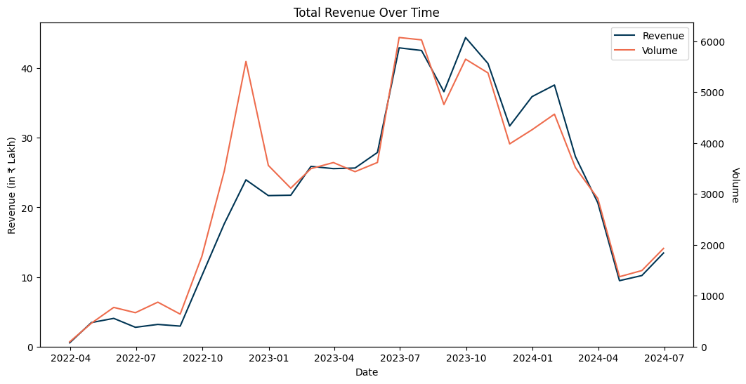
Revenue and Order Volume Trends
Industry Overview
Amazon
Flipkart
Meesho
Comparative Analysis

Slide 23
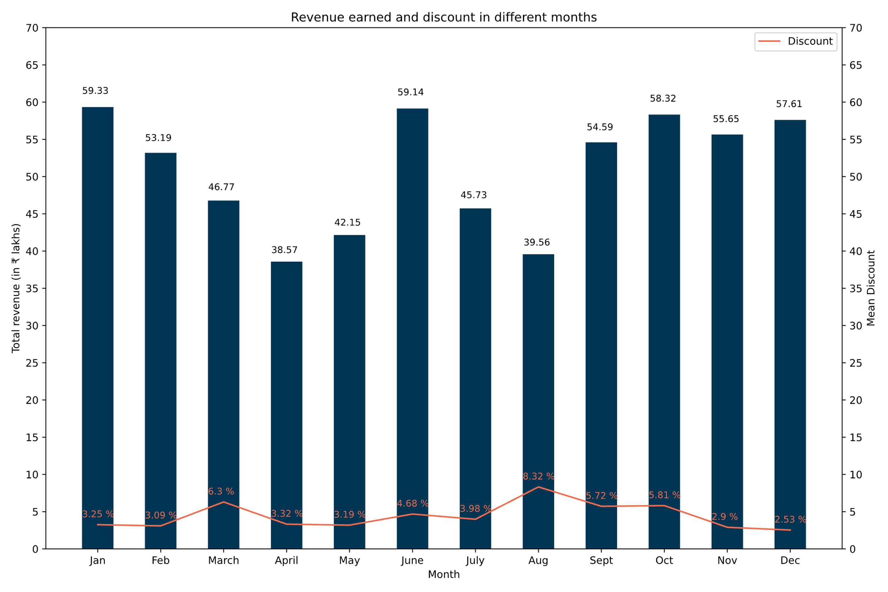
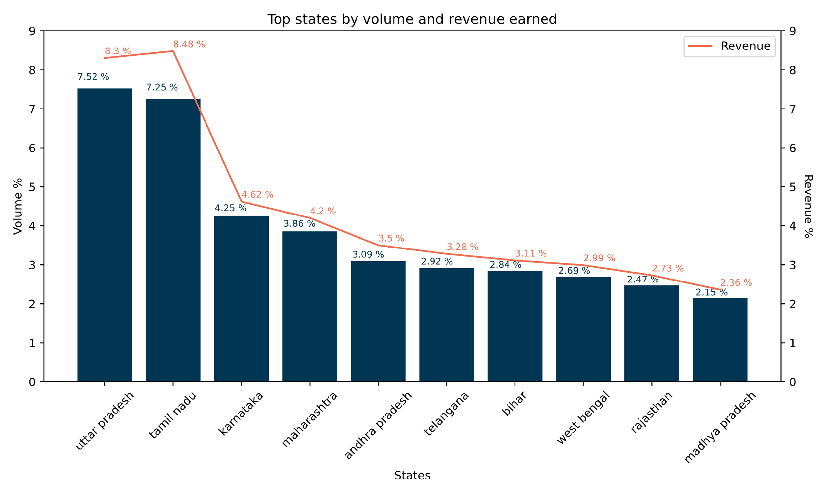
Purchase, Revenue and Discount Trends
Industry Overview
Amazon
Flipkart
Meesho
Comparative Analysis

Slide 24
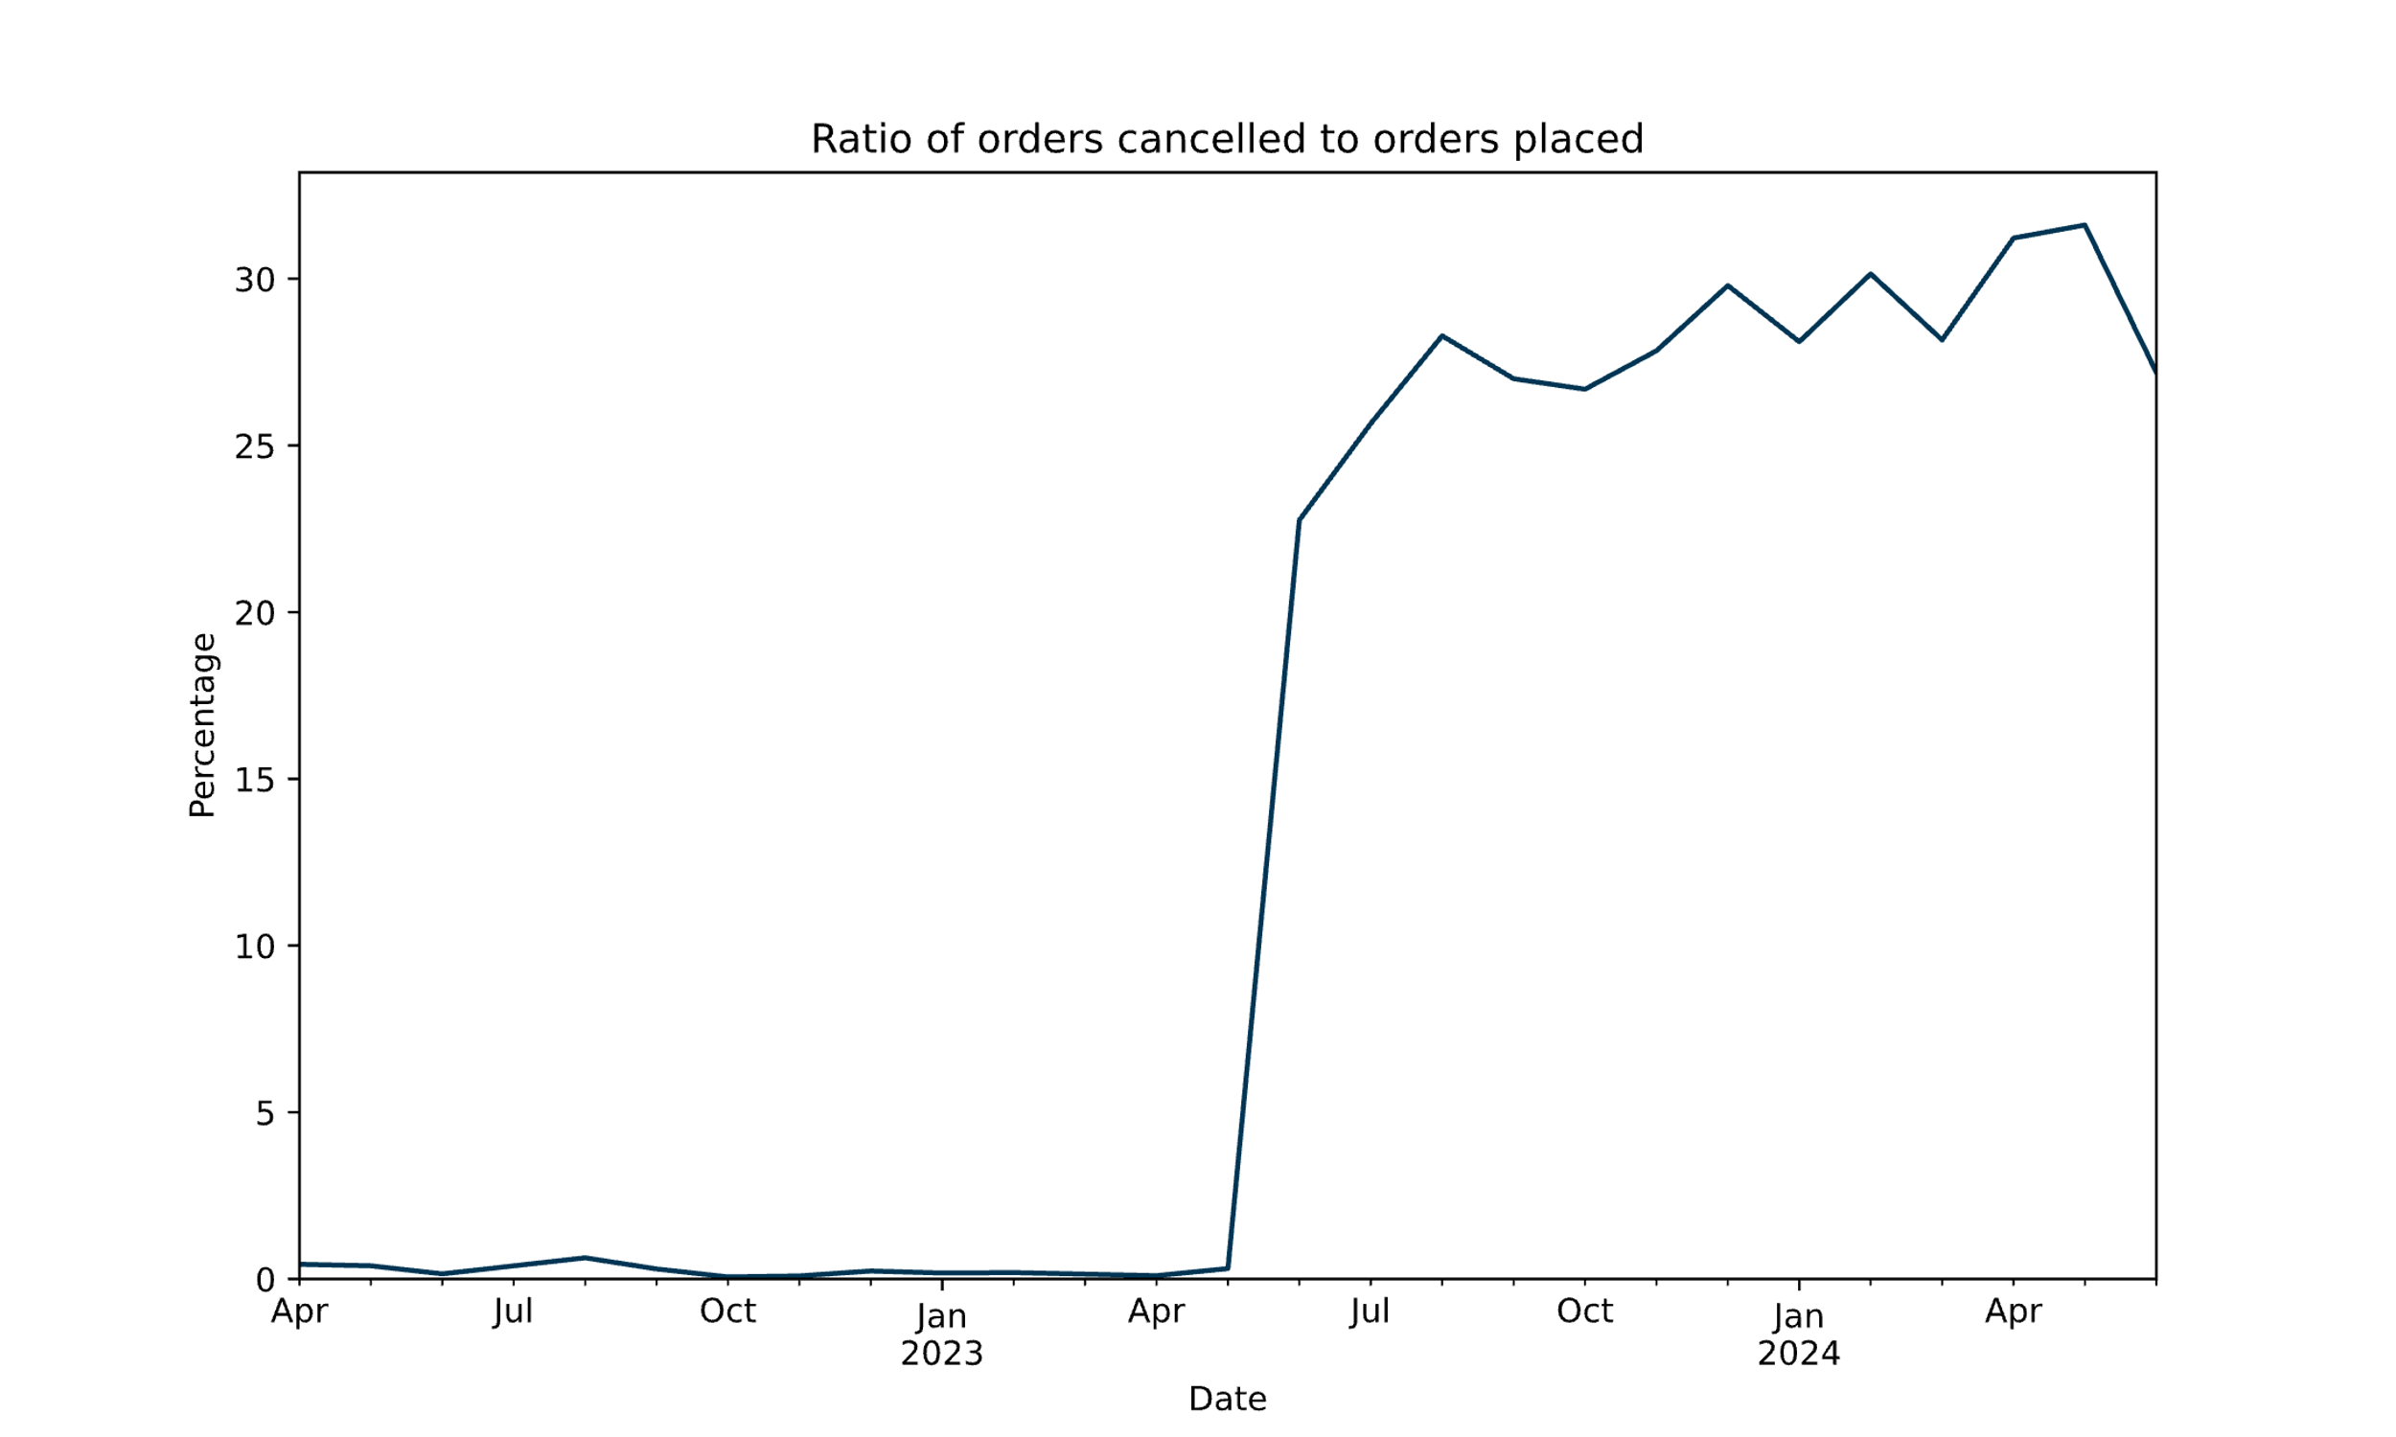
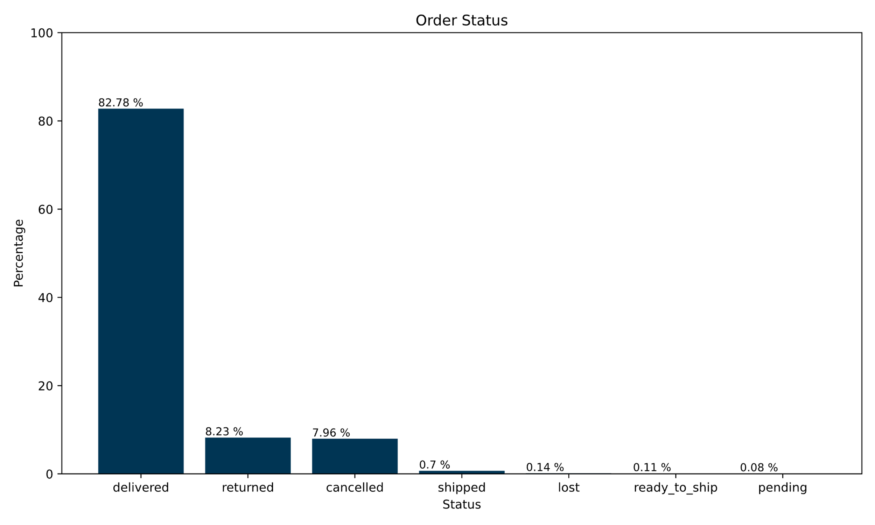
Order Status & Cancellation Trends
Industry Overview
Amazon
Flipkart
Meesho
Comparative Analysis

Slide 25
Industry Overview
Amazon
Flipkart
Meesho
Comparative Analysis

